Slide 1
Polymer Representation for BO and AL
Syed Omer Shah – 12/30/25

Slide 2
Week 2 Task Progress
Added Butina algorithm for morgan fingerprint
Added Smart motifs with RDKit
Visualized Graph representation via GNN (GIN)
Added Distribution (histogram, mean)
Property labels after histogram
SELFIE + SMARTs representation done

Slide 3
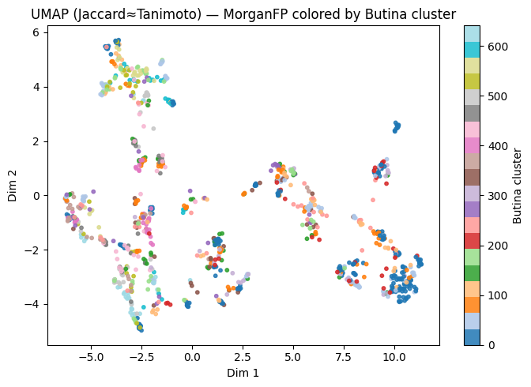
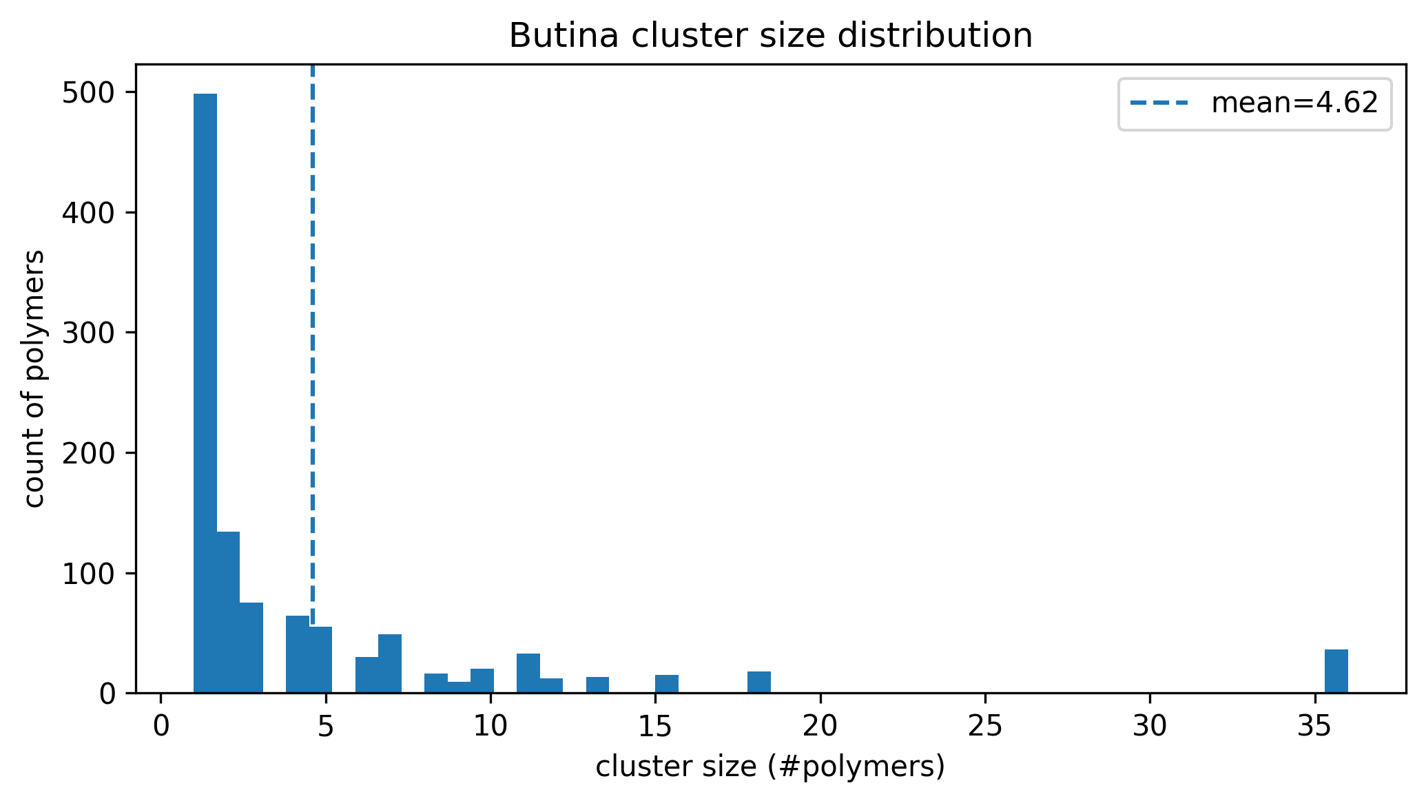
Butina for Morgan FP

Slide 4
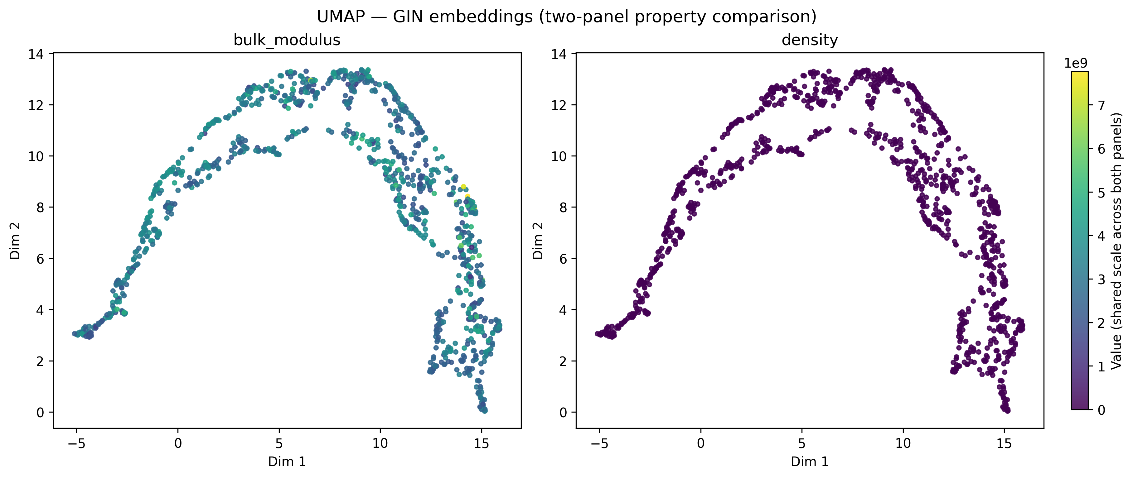
GIN embeddings property comparision

Slide 5
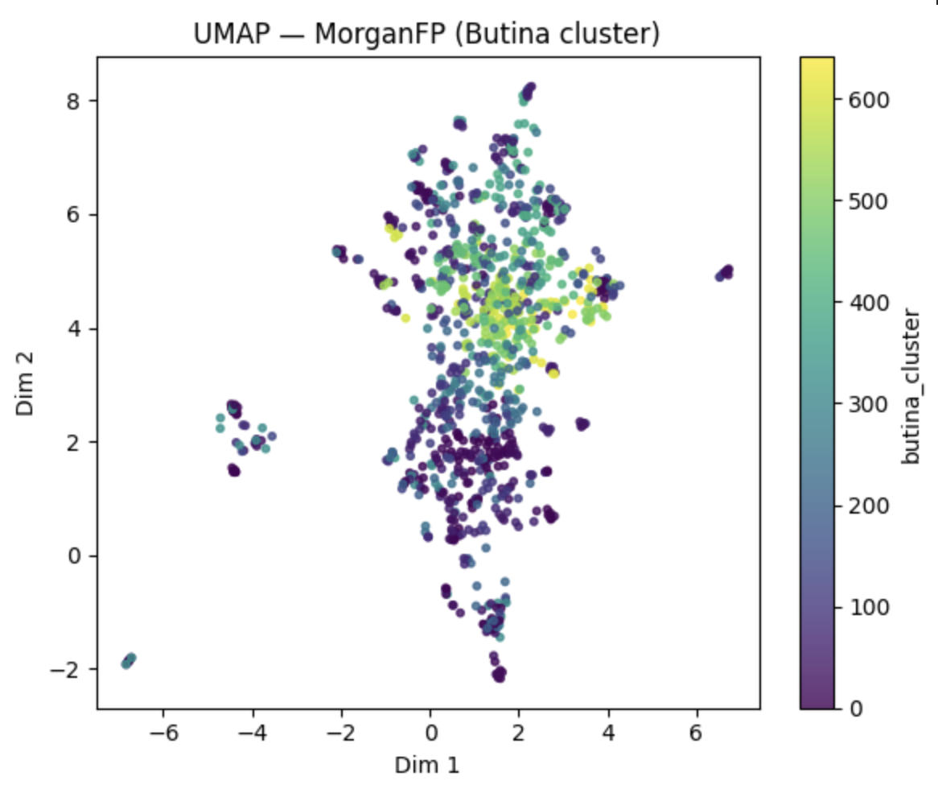
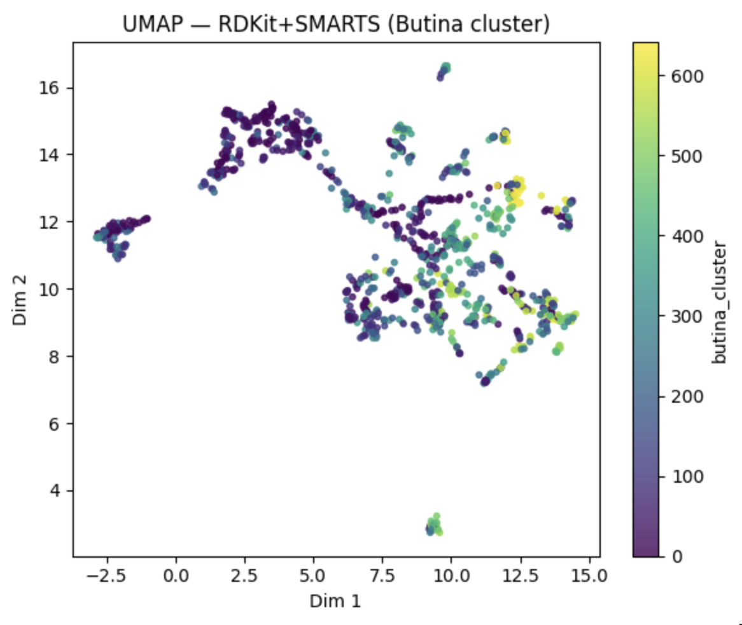
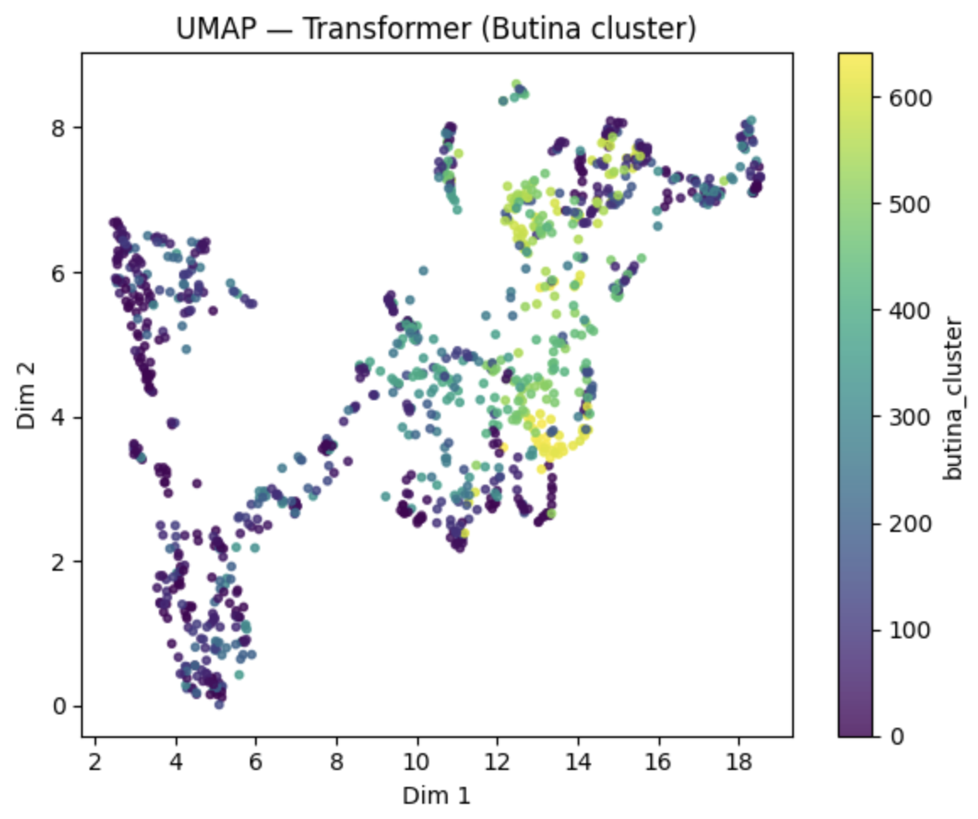
UMAP for different representations

Slide 6
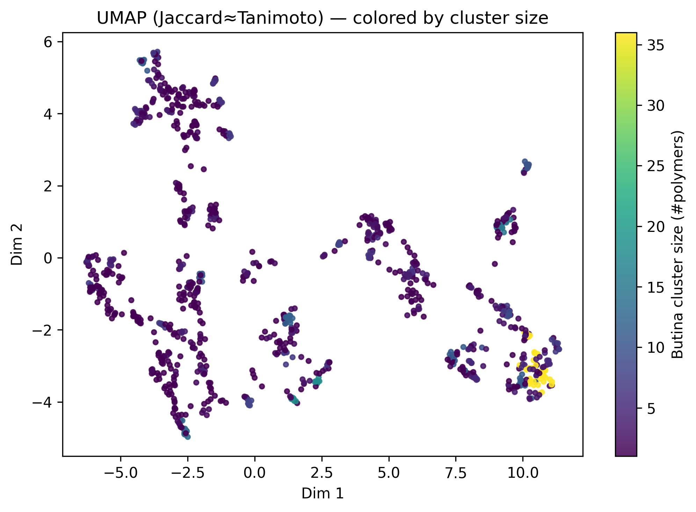
UMAP for Butina

Slide 7
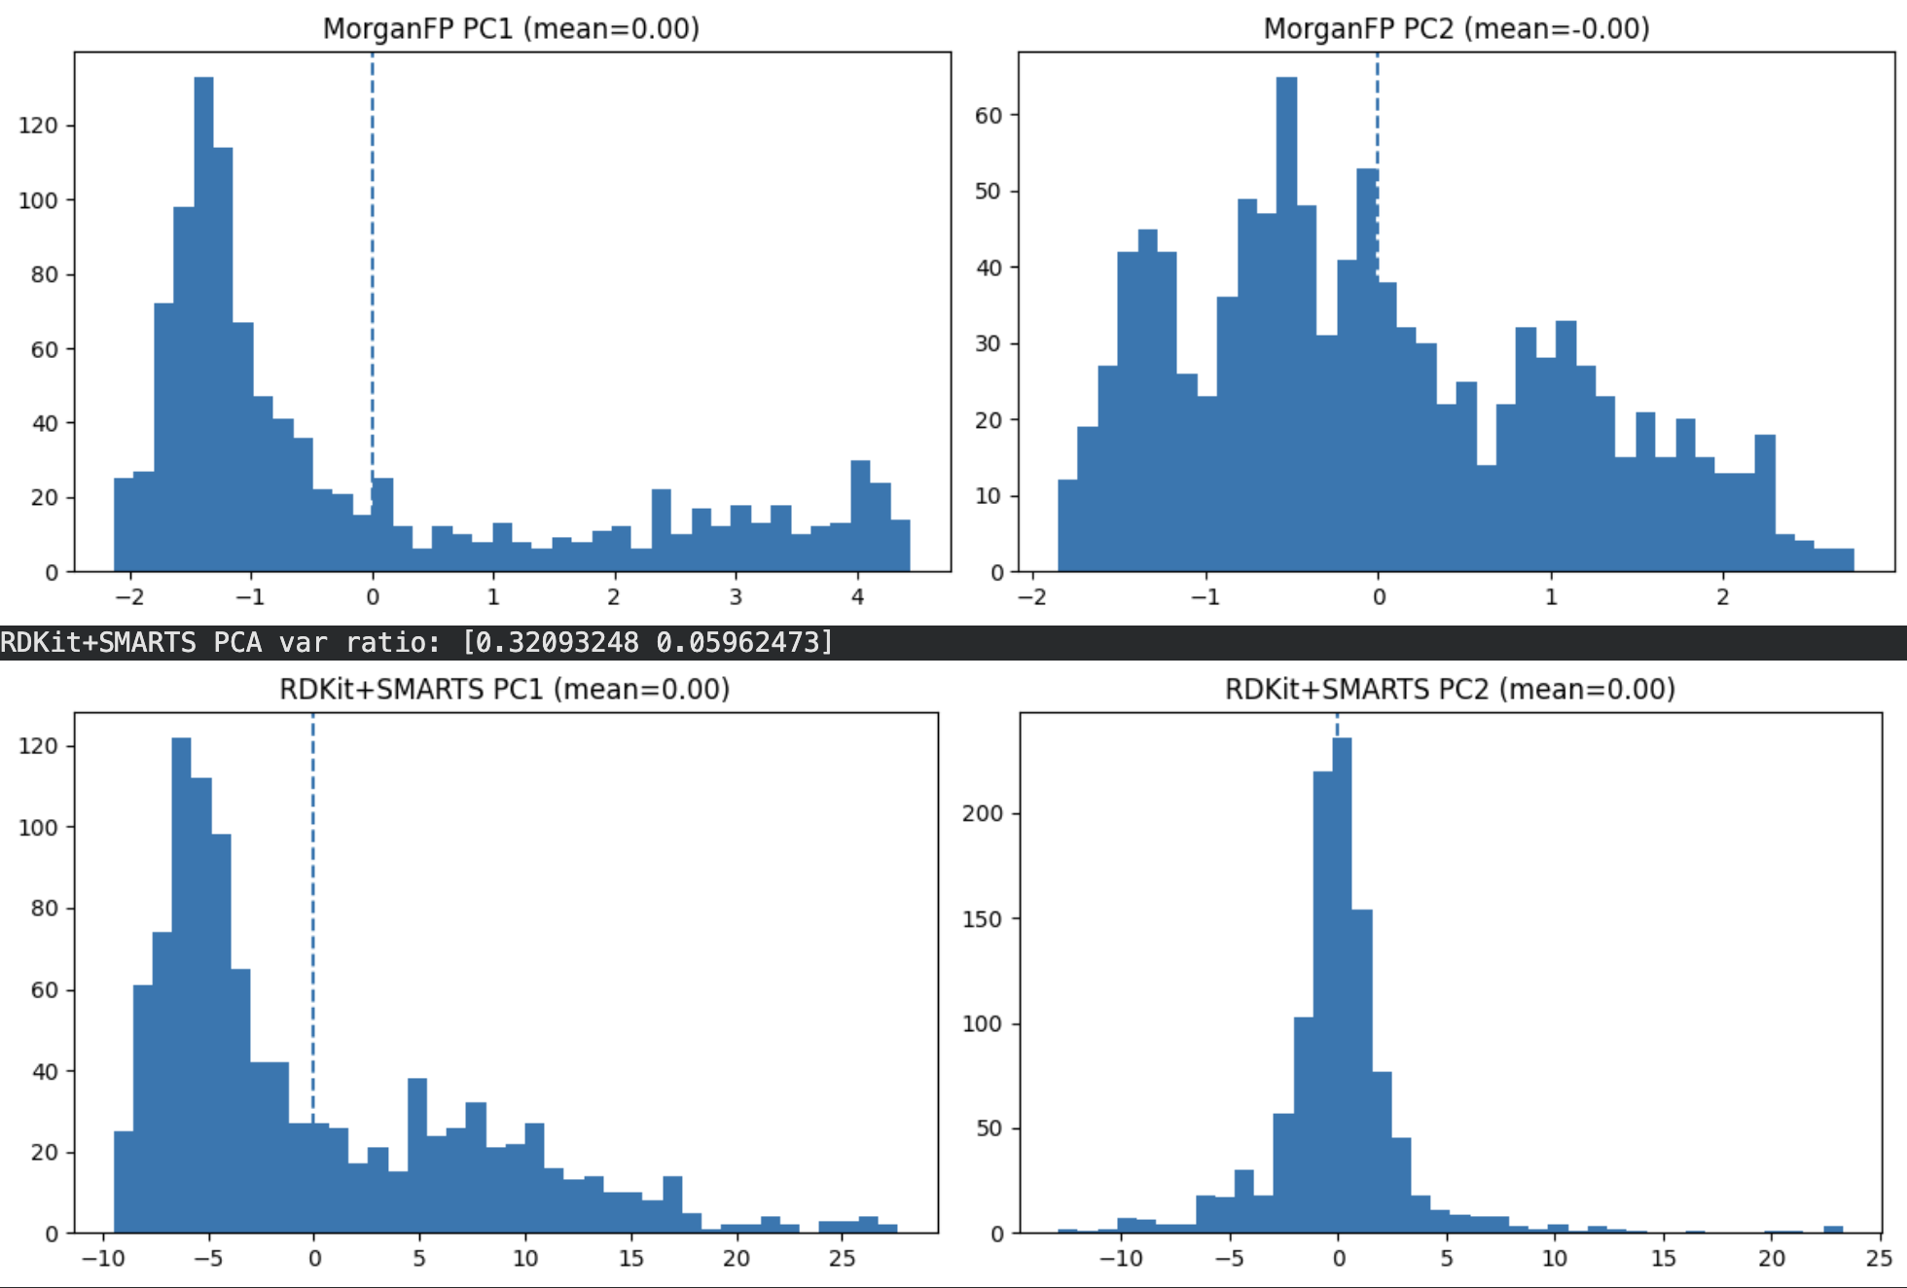
Histograms

Slide 8
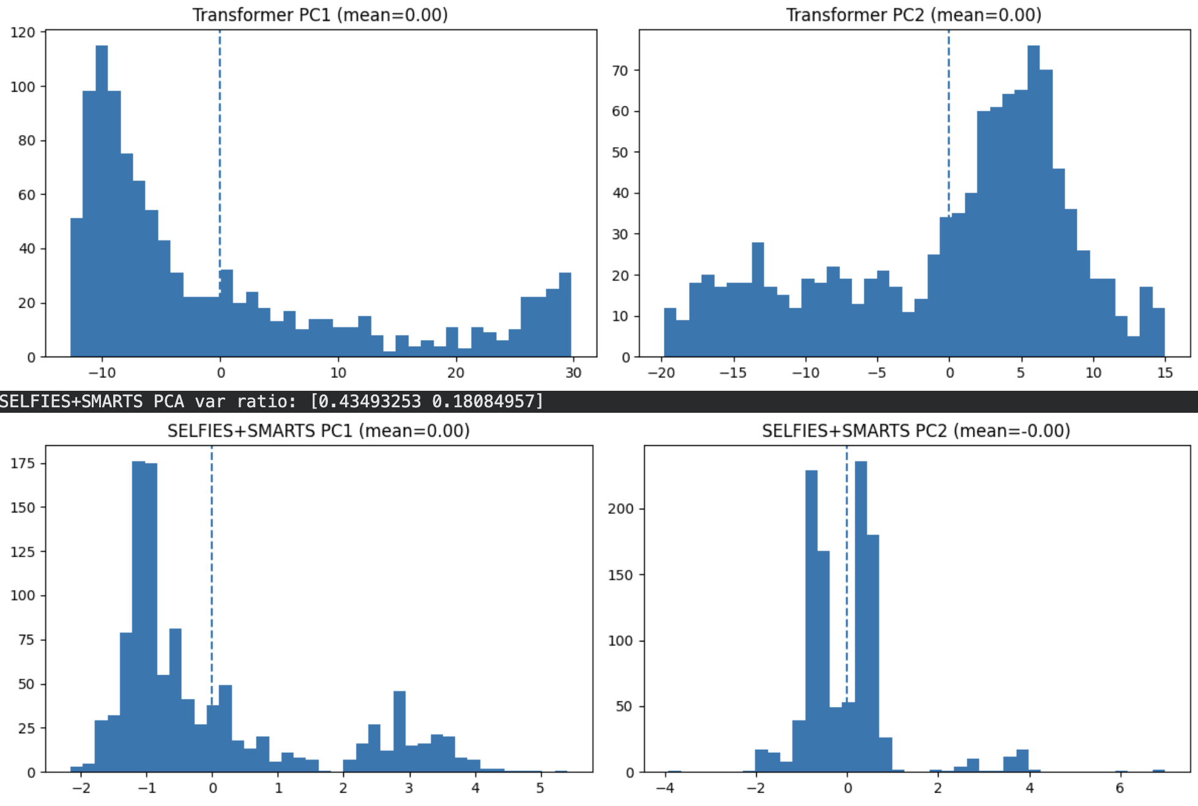
Histograms

Slide 9
Thank You

Slide 10
Polymer Representation for BO and AL
Syed Omer Shah – 12/23/25

Slide 11
Weekly Update: Task 1 Progress
Loaded and cleaned PI1070 dataset (1077 valid polymer SMILES)
Generated 3 polymer representations:
1. Morgan Fingerprints (ECFP)
2. RDKit Descriptors (+ SMARTS motif counts)
3. SMILES Transformer embeddings (PolyBERT, SELFIEs)
Visualized “polymer chemical space” via UMAP and colored by polymer_class + key properties

Slide 12
Dataset (PI1070)
Data used: ~1077 valid polymers after SMILES parsing
Labels/metadata include:
polymer_class (categorical)
Properties: density, bulk_modulus, thermal_conductivity, static_dielectric_const

Slide 13
Representation 1: Morgan Fingerprints (ECFP)
What it is
2048-bit binary vector capturing local substructure patterns (motifs)
X_morgan shape: (1077, 2048)
What it emphasizes
Presence/absence of chemical motifs → tends to form discrete clusters

Slide 14
Representation 2: RDKit Descriptors
What it is
Continuous physchem features (MW, rings, polarity, etc.)
Raw descriptors: 217 → kept 209 valid after dropping all-NaN columns
X_desc shape: (1077, 209)
What it emphasizes
Global molecular trends (size/packing/polarity) → often yields smoother manifolds

Slide 15
Representation 3: SMILES Transformer Embeddings (PolyBERT)
What it is
Learned sequence-based embedding from SMILES using pretrained transformer
CLS pooling → fixed-length vector
X_tx shape: (1077, 600)
What it emphasizes
Learned “chemical semantics” from SMILES patterns → smooth continuous geometry

Slide 16
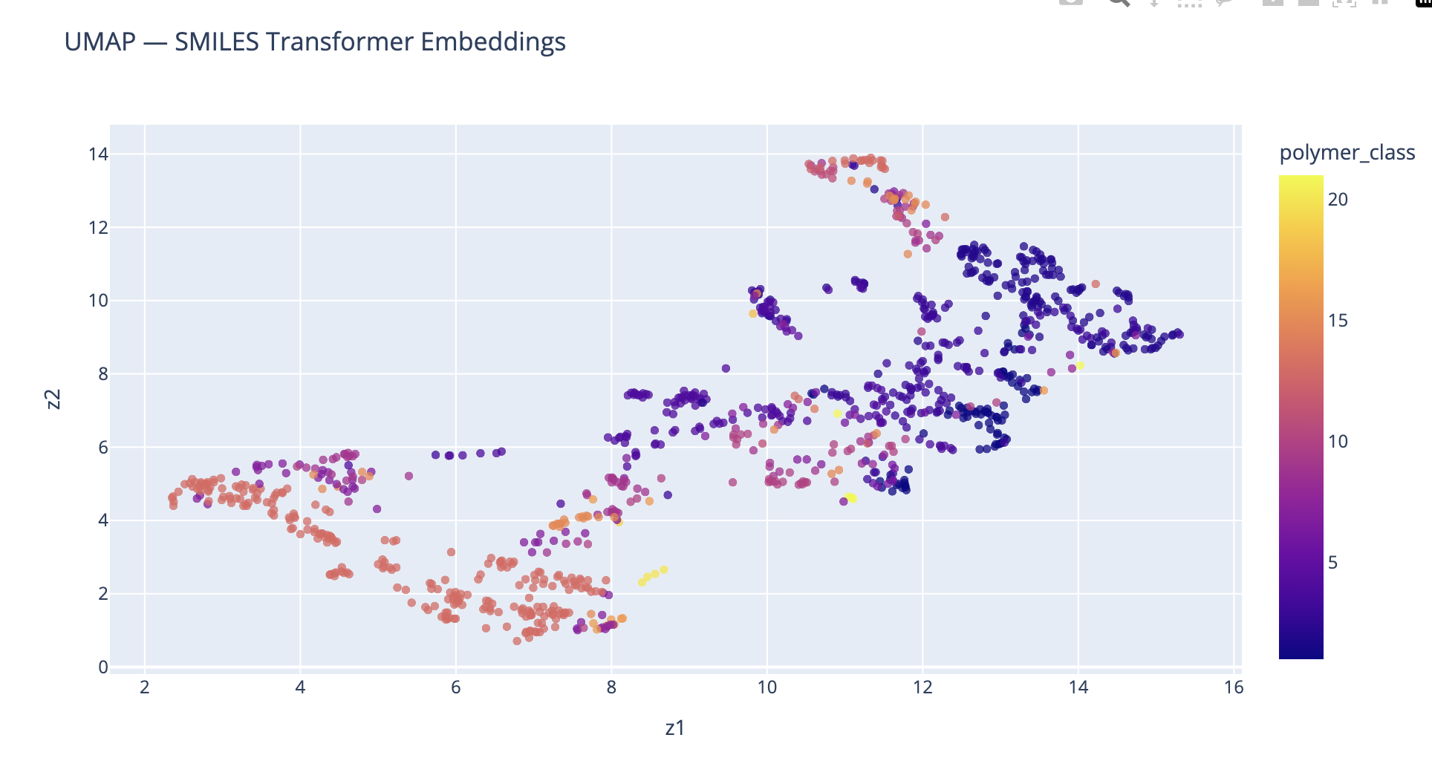
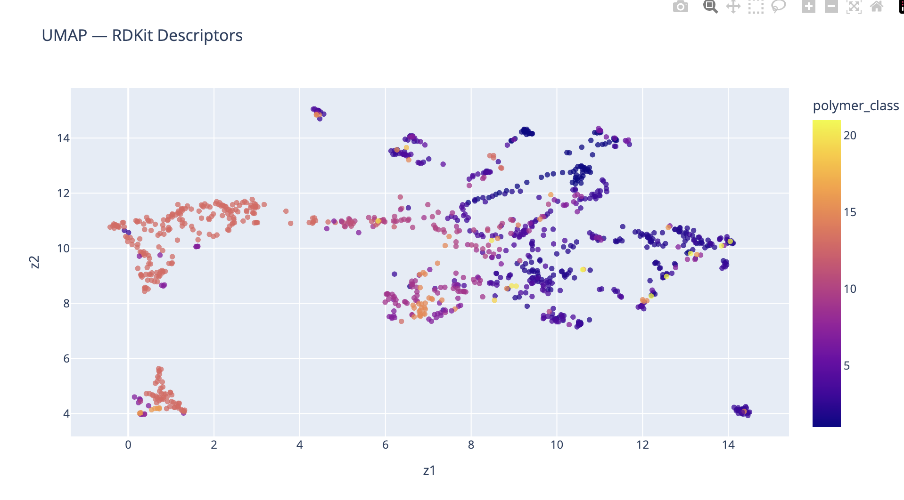
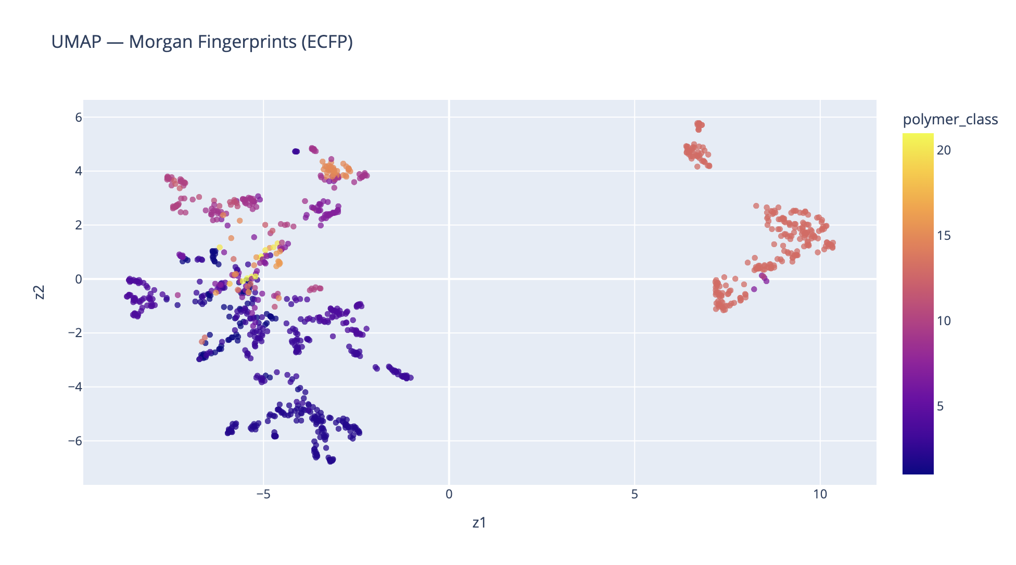
UMAP: Polymer Class Separation

Slide 17
Observations
MorganFP shows more distinct islands (motif-based separation)
RDKit descriptors show a smoother space with some separated islands
Transformer embeddings form a large connected manifold with some separated regions
All representations capture class structure but in different ways → complementary views

Slide 18
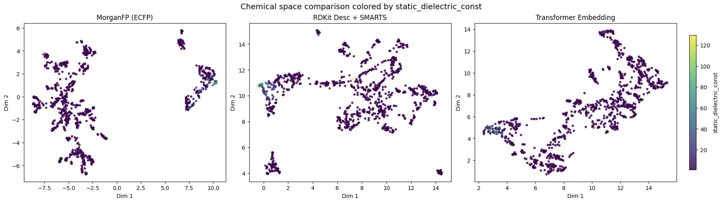
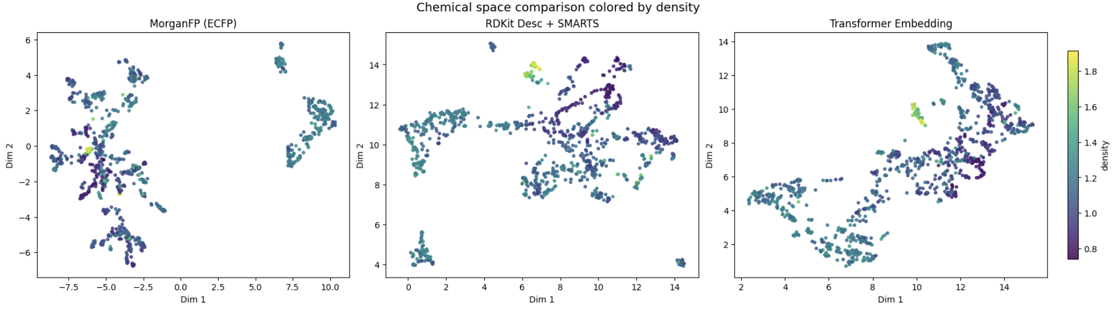
UMAP: Property Trends

Slide 19
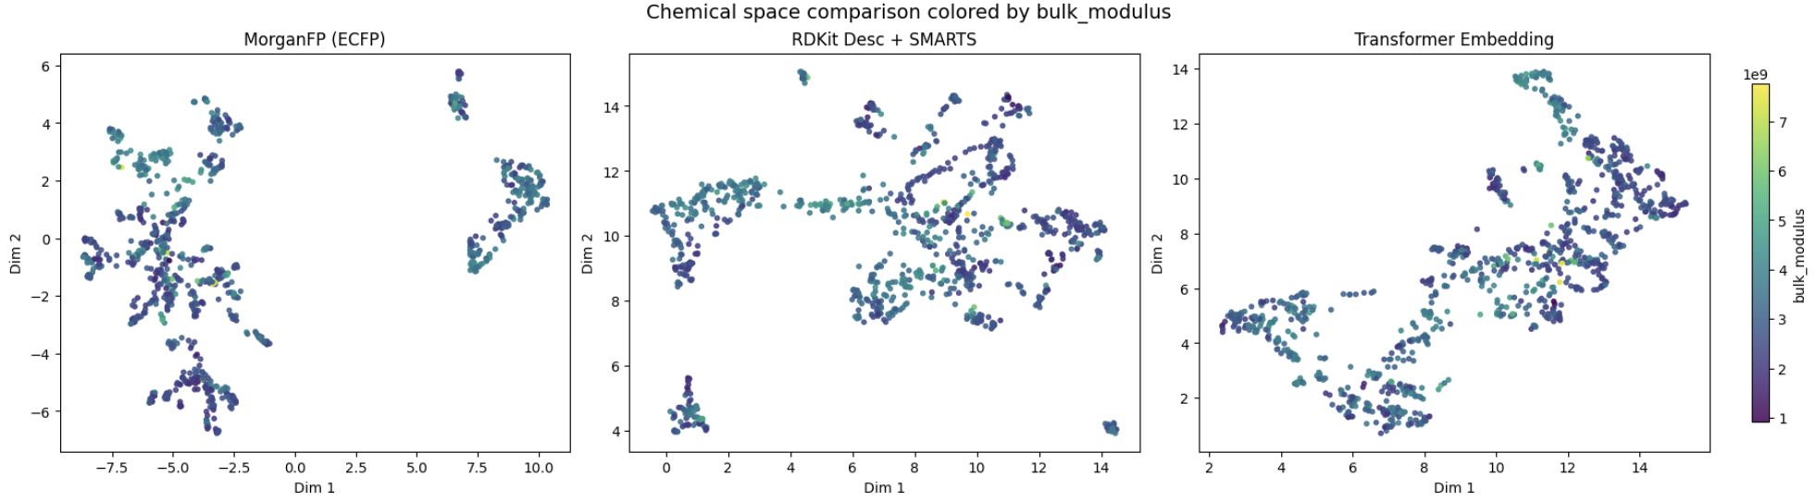
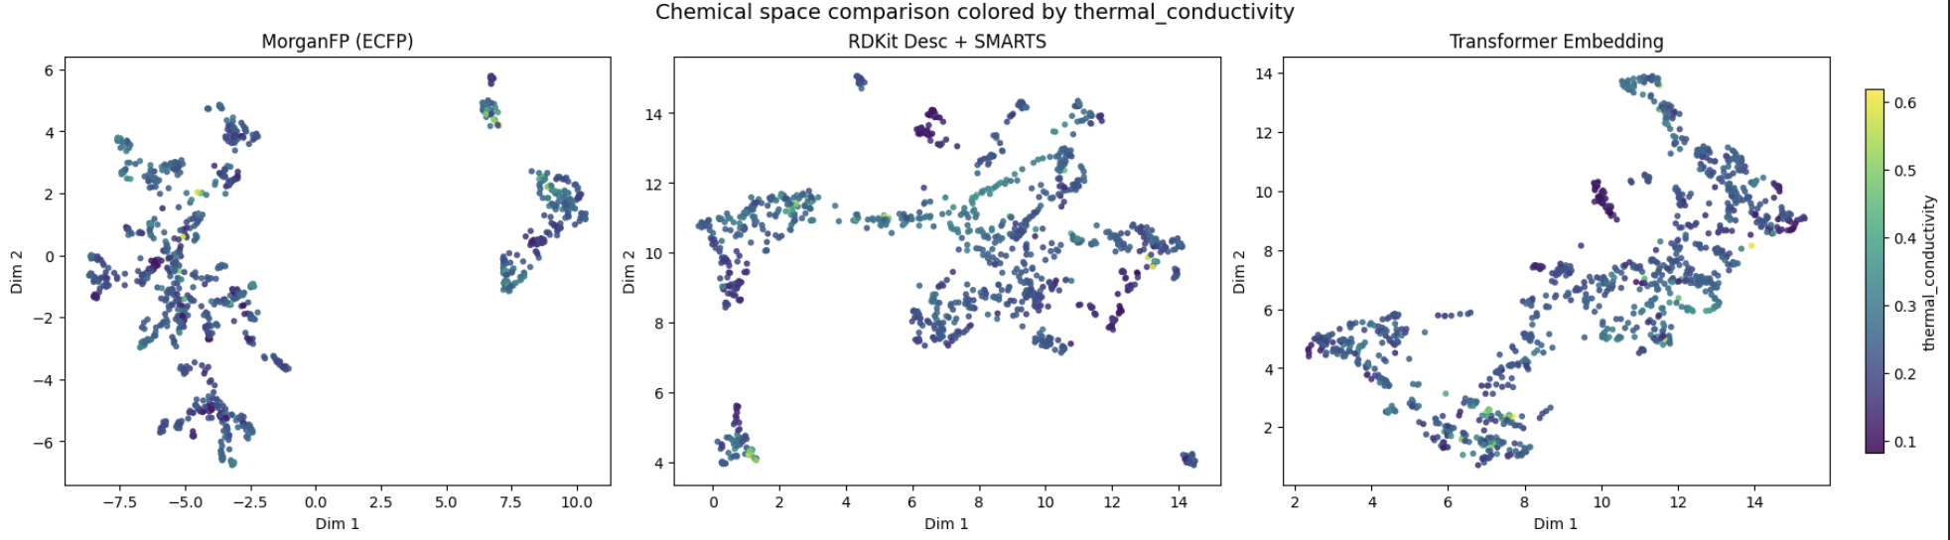
UMAP: Property Trends

Slide 20
Observations
Smooth color gradients in a region → property correlates with representation geometry
Patchy colors → property not well-aligned or noisy
Density and thermal conductivity show visible gradients/regions in multiple spaces
Bulk modulus shows structure but not perfectly separable → depends on multiple factors

Slide 21
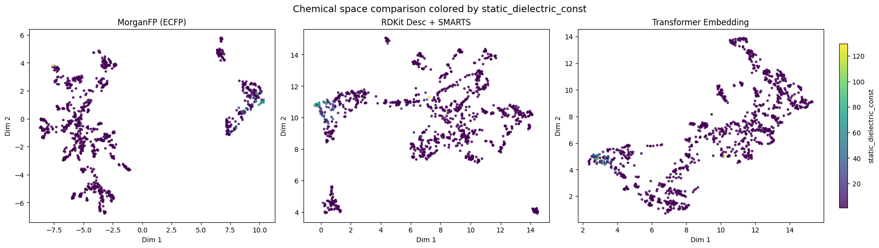
Static Dielectric Constant Plot

Slide 22
Observation
Most points are dark with a few very bright values → strong skew / outliers dominate the colorbar
Hard to visually interpret trends without preprocessing

Slide 23
Tasks to do
Butina algorithm for morgan fingerprint
Smart motifs
Graph rep (gin)
Distribution (histogram, mean)
Polymer classes = cluster label (representation)
Property labels after histogram
SELFIE + SMARTs

Slide 24
Key Learnings
1. Multi-View Polymer Representations
Used four modalities: tabular fingerprints, GNNs, 3D GraphMVP, SMILES LMs.
Ensemble of these gave best property predictions (Tg, Tc, FFV, ρ, Rg).
Multi-view = complementary info to robust surrogate model.
Added uncertainty via ensemble disagreement which is perfect for BO/AL.
2. PolyTAO + Group SELFIES
Generator for inverse design with 100 % valid polymers.
Uses Group SELFIES tokens → chemically valid always.
Adds reinforcement-learning fine-tuning (PRECISE) → property-controlled generation.

Slide 25
Key Learnings
GRIN (Learning Repetition-Invariant Representations)
New polymer-specific model: Graph Repetition Invariance.
Aligns embeddings for chains with different repeat counts, consistent vectors.
Handles homopolymers & copolymers; outperforms baselines.
Best suited for polymers in BO (smooth, length-agnostic representation).
UMA & Omni-Mol
UMA – universal atomic-scale model pretrained on ½ billion structures; strong zero-shot generalization.
Omni-Mol – LLM trained on 16 chemistry tasks using SMILES/SELFIES + text + numeric modalities.
Both supply pretrained molecular embeddings usable as feature inputs for polymers.

Slide 26
Proposed BO + AL loop
Representation (GRIN + Omni-Mol/UMA + Fingerprints)
Surrogate Model (predicts Tg, Tc, etc. + uncertainty)
Acquisition Function (Expected Improvement / UCB)
Generator (PolyTAO + Group SELFIES): new polymer SMILES
Accept/Reject Step (based on predicted criteria)
Feedback Loop & RL Fine-Tuning (PRECISE-style)

Slide 27
Specifications
GRIN (Polymer-Specific Graph Embedding)
Learns repetition-invariant graph embeddings.
Ensures same polymer = same vector regardless of chain length.
Ideal for smooth surrogate learning in BO.
Pros: polymer-specific, stable, interpretable.
Cons: needs molecular graphs, more compute.
Omni-Mol / UMA (Pretrained SMILES Models)
Omni-Mol: multi-task LLM on SMILES/SELFIES → dense language embeddings.
UMA: universal graph model, transferable atomic features.
Adds global chemical context, better generalization in low-data polymer tasks.
Pros: SMILES-compatible, pretrained knowledge.
Cons: not inherently repetition-invariant → needs fine-tuning with polymer data.

Slide 28
Specifications
Fingerprints (Baseline)
Classical RDKit / Morgan Fingerprints + physicochemical descriptors.
Serves as simple baseline for BO.
Pros: fast, interpretable, BO-ready.
Cons: lacks polymer structure context, limited generalization.

Slide 29
Recommendation & Next Steps
Baseline Setup: Fingerprint + Omni-Mol embedding → simple Gaussian Process BO.
Advanced Setup: Multi-view fusion of GRIN + Omni-Mol/UMA + fingerprints.
Integration: Use PolyTAO generator for candidate sampling.
Uncertainty: Ensemble / dropout / SMILES-TTA.
Future work: RL fine-tuning loop → target-guided polymer design.
Outcome: A universal, repetition-invariant representation for efficient polymer optimization.

